Slide 1
EBN 111/122 ELECTRICITY AND ELECTRONICS
Chapter 10
Sinusoidal Steady-State Analysis

Slide 2
Sinusoidal Steady-State Analysis Chapter 10
10.1 Basic Approach
10.2 Nodal Analysis
10.3 Mesh Analysis
10.4 Superposition Theorem
10.5 Source Transformation
10.6 Thevenin and Norton Equivalent Circuits

Slide 3
Steps to Analyze AC Circuits:
10.1 Basic Approach (1)
Transform the circuit to the phasor or frequency domain.
Solve the problem using circuit techniques (nodal analysis, mesh analysis, superposition, etc.).
Transform the resulting phasor to the time domain.
Time to Phasor
Solve variables in Phasor
Phasor to Time

Slide 4
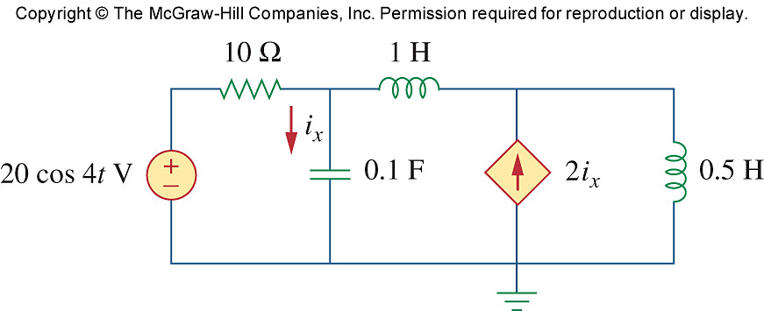
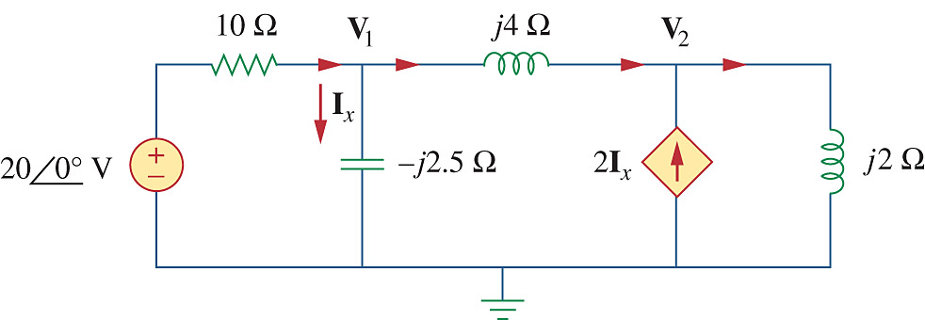
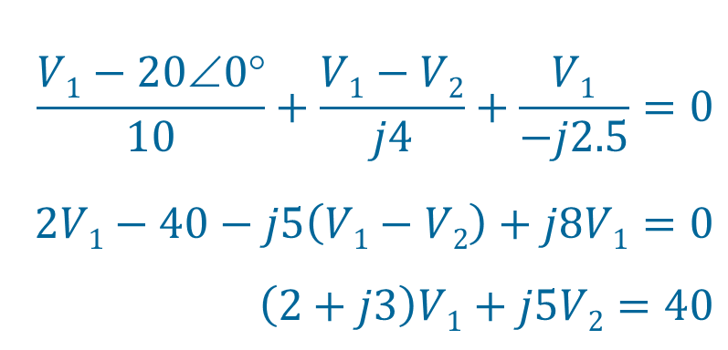
10.2 Nodal Analysis
Example 10.1 Determine i_{x}.
jX_{L} = jωL = j × 4 × 1 = j4
jX_{L} = jωL = j × 4 × 0.5 = j2
jX_{C} = -j/ωC = -j ÷ (4 × 0.1) = -j2.5
KCL at node 1:
$$\frac{V1−20∠0°}{10}+\frac{V1−V2}{j4}+\frac{V1}{−j2.5}=0$$
$$2V1−40−j5\left(V1−V2\right)+j8V1=0$$
$$\left(2+j3\right)V1+j5V2=40$$
(x20)
1

Slide 5
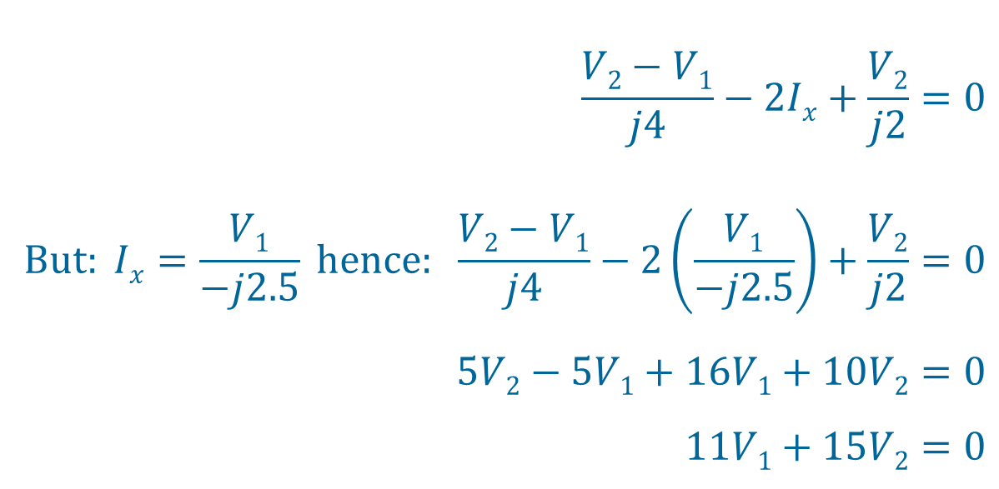
Example 10.1 cont Determine i_{x}.
KCL at node 2:
$$\frac{V2−V1}{j4}−2Ix+\frac{V2}{j2}=0$$
$$But: Ix=\frac{V1}{−j2.5} hence: \frac{V2−V1}{j4}−2\left(\frac{V1}{−j2.5}\right)+\frac{V2}{j2}=0$$
$$5V2−5V1+16V1+10V2=0$$
$$11V1+15V2=0$$
(×j20)
2

Slide 6

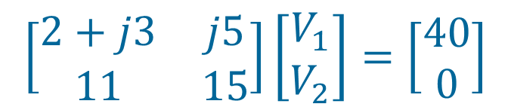
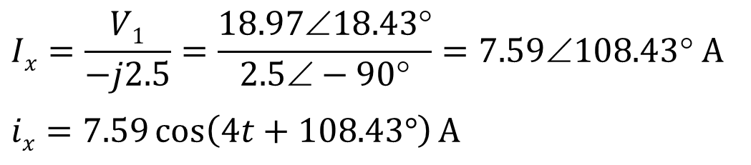
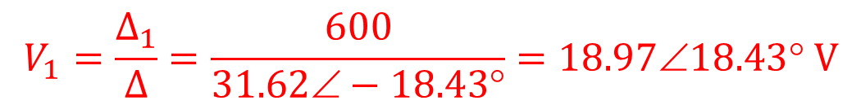
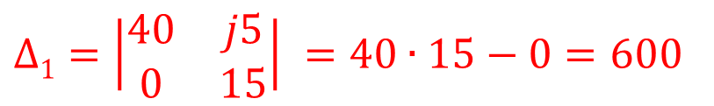
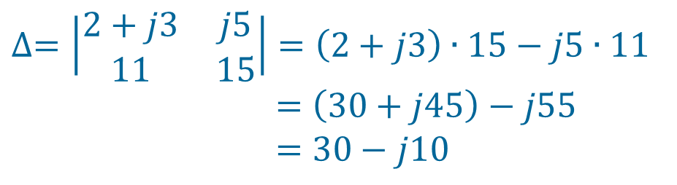
Example 10.1 cont Determine i_{x}.
$$\left[\begin{matrix}2+j3 & j5 \\ 11 & 15\end{matrix}\right]\left[\begin{matrix}V_{1} \\ V_{2}\end{matrix}\right]=\left[\begin{matrix}40 \\ 0\end{matrix}\right]$$
$$∆=\left|\begin{matrix}2+j3 & j5 \\ 11 & 15\end{matrix}\right|=\left(2+j3\right)∙15−j5∙11$$
$$=\left(30+j45\right)−j55$$
$$=30−j10$$
$$∆1=\left|\begin{matrix}40 & j5 \\ 0 & 15\end{matrix}\right| =40∙15−0=600$$
$$V_{1}=\frac{∆_{1}}{∆}=\frac{600}{31.62∠−18.43°}=18.97∠18.43° V$$
$$Ix=\frac{V1}{−j2.5}=\frac{18.97∠18.43°}{2.5∠−90°}=7.59∠108.43° A$$
$$ix=7.59\cos\left(4t+108.43°\right)A$$

Slide 7
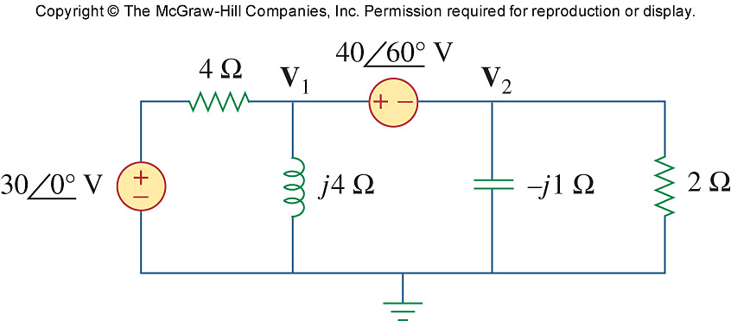
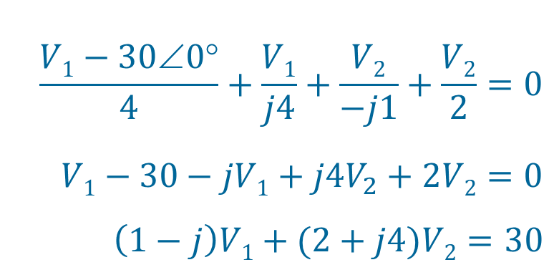
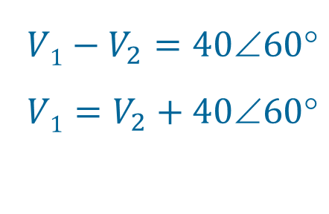
PP 10.2 (Super Node) Determine V₁ and V₂.
KCL at Super node:
$$\frac{V1−30∠0°}{4}+\frac{V1}{j4}+\frac{V2}{−j1}+\frac{V2}{2}=0$$
$$V1−30−jV1+j4V_{2}+2V2=0$$
$$\left(1−j\right)V1+(2+j4)V2=30$$
(× 4)
1
Super node:
$$V1−V_{2}=4060$$
$$V1=V_{2}+4060$$
2

Slide 8
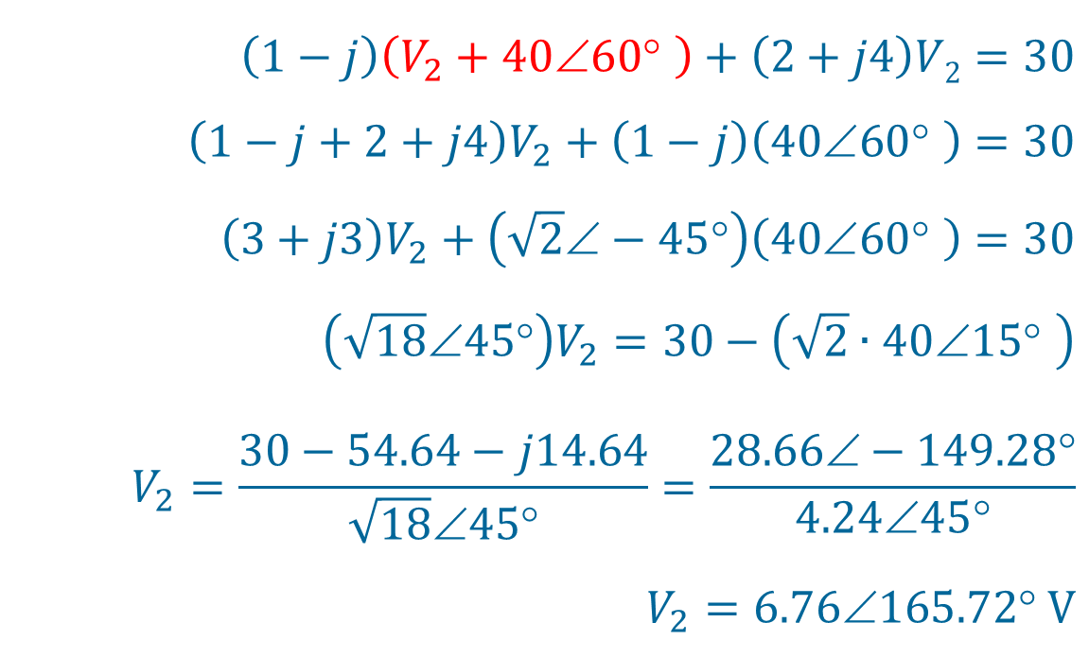
PP 10.2 cont … Determine V₁ and V₂.
2
in
1
$$\left(1−j\right)\left(V_{2}+40∠60° \right)+\left(2+j4\right)V2=30$$
$$\left(1−j+2+j4\right)V_{2}+\left(1−j\right)\left(40∠60° \right)=30$$
$$\left(3+j3\right)V_{2}+\left(\sqrt{2}∠−45°\right)\left(40∠60° \right)=30$$
$$\left(\sqrt{18}∠45°\right)V_{2}=30−\left(\sqrt{2}∙40∠15° \right)$$
$$V_{2}=\frac{30−54.64−j14.64}{\sqrt{18}∠45°}=\frac{28.66∠−149.28°}{4.24∠45°}$$
$$V_{2}=6.76165.72 V$$
3

Slide 9
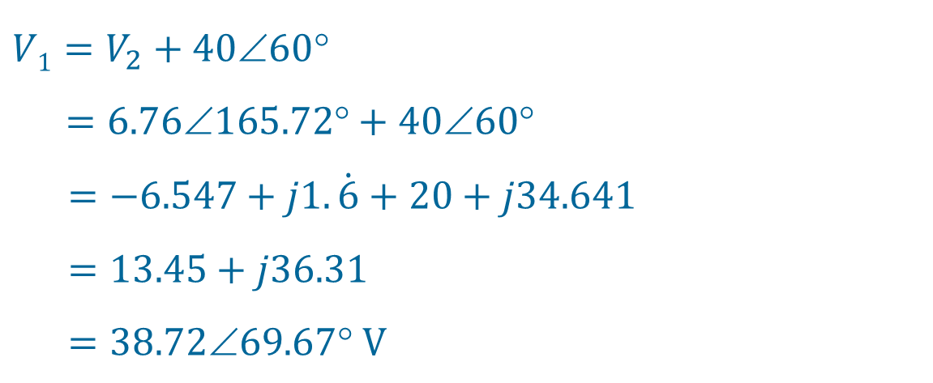
PP 10.2 cont … Determine V₁ and V₂.
3
in
2
$$V1=V_{2}+4060$$
$$=6.76165.72+4060$$
$=−6.547+j1.\dot{6}+20+j34.641$
$=13.45+j36.31$
$=38.7269.67 V$

Slide 10
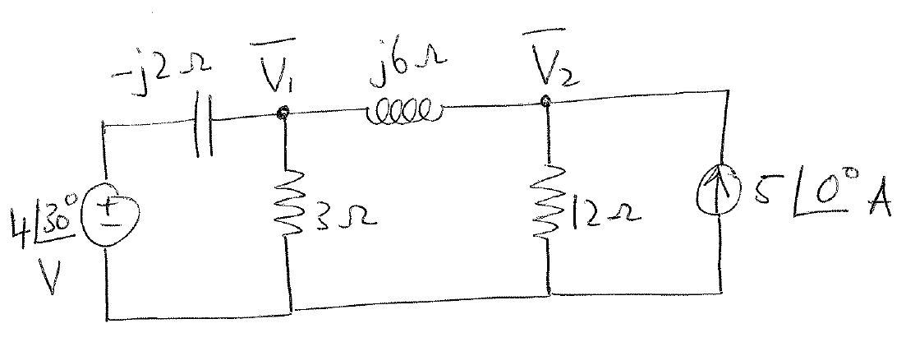
Example 1: Set up the nodal analysis equations for V₁ and V₂. Write it in the following form:
(a₁ + jb₁)V₁ + (a₂ +jb₂)V₂ = A₃∠φ₃
(a₄ + jb₄)V₁ + (a₅ +jb₅)V₂ = A₆∠φ₆

Slide 11
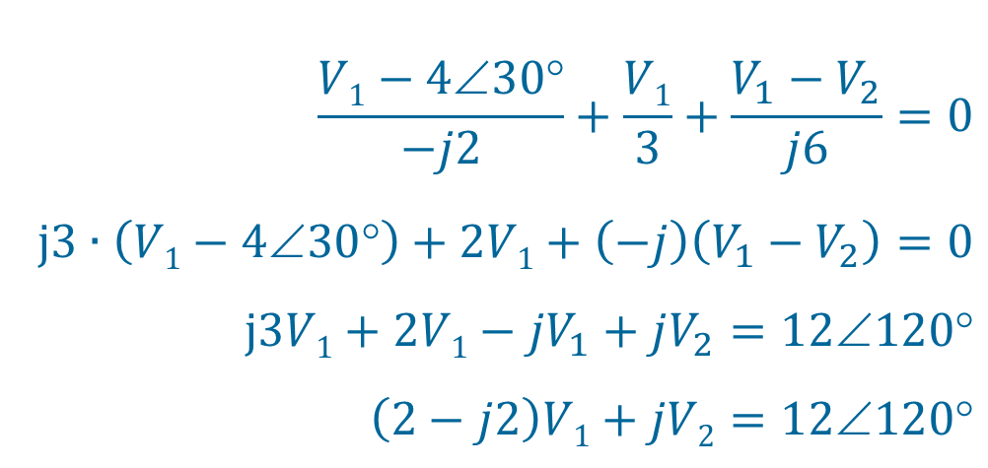
Exercise:
KCL at Node 1:
$$\frac{V1−4∠30°}{−j2}+\frac{V1}{3}+\frac{V_{1}−V_{2}}{j6}=0$$
$$j3∙\left(V1−4∠30°\right)+2V1+\left(−j\right)\left(V_{1}−V_{2}\right)=0$$
$$j3V1+2V1−jV_{1}+jV_{2}=12120$$
$$\left(2−j2\right)V1+jV2=12∠120°$$
(× 6)
(a₁ + jb₁)V₁ + (a₂ +jb₂)V₂ = A₃∠φ₃
a₁ = 2; b₁ = -2; a₂ = 0; b₂ = 1; A₃ = 12; φ₃ = 120°

Slide 12
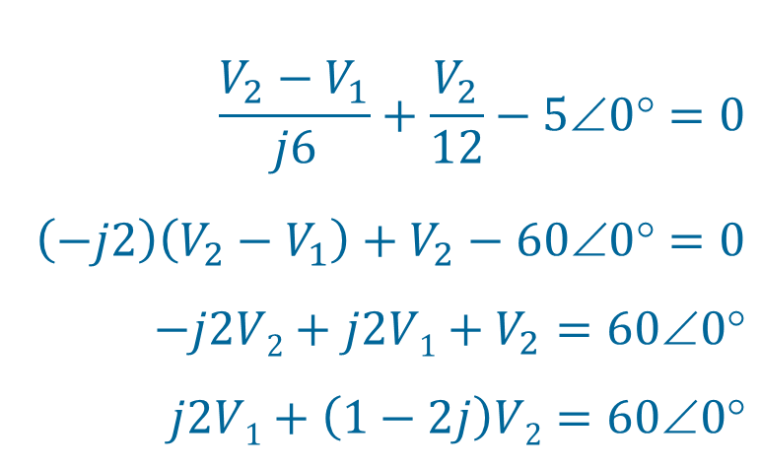
Exercise cont…
KCL at Node 2:
$$\frac{V_{2}−V_{1}}{j6}+\frac{V_{2}}{12}−5∠0°=0$$
$$\left(−j2\right)\left(V_{2}−V_{1}\right)+V_{2}−60∠0°=0$$
$$−j2V2+j2V1+V_{2}=600$$
$$j2V1+\left(1−2j\right)V2=60∠0°$$
(× 12)
(a₄ + jb₄)V₁ + (a₅ +jb₅)V₂ = A₆∠φ₆
a₄ = 0; b₄ = 2; a₅ = 1; b₅ = -2; A₆ = 60; φ₆ = 0°

Slide 13
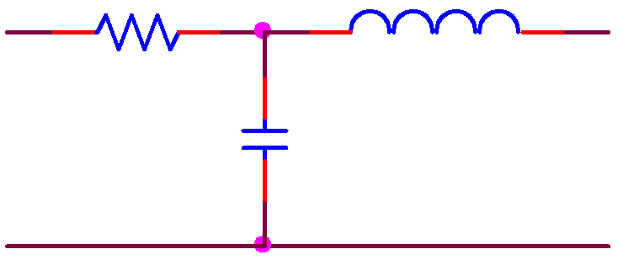




Ch. 10 L#2 10.3 Mesh Analysis
6 Ω
j2 Ω
+ 6I₁ –
+ j2I₂ –
+
-j3I₁
–
–
-j3I₂
+
I₂
I₁
-j3 Ω
$$…+6I_{1}+\left(−j3\right)\left(I_{1}−I_{2}\right)=0$$
$$…+j2I_{2}+\left(−j3\right)\left(I_{2}−I_{1}\right)=0$$
I
+
V = IZ
–
I
–
V = – IZ
+
Z
Z

Slide 14
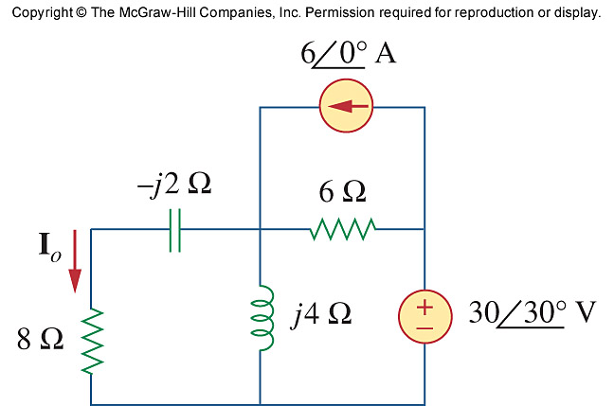
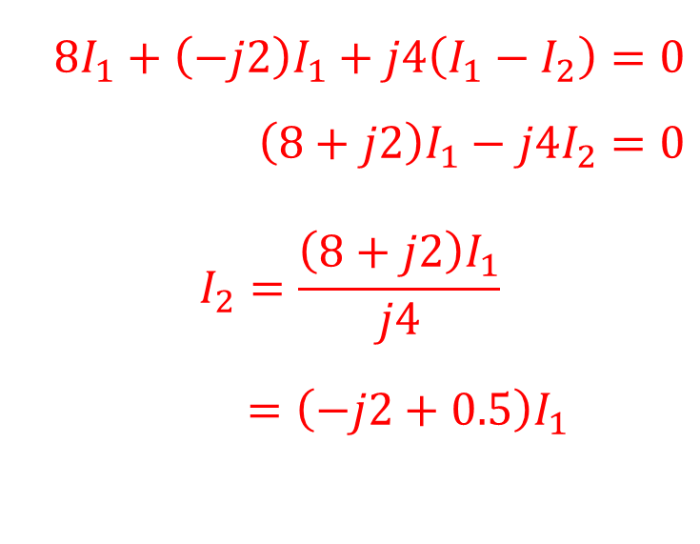
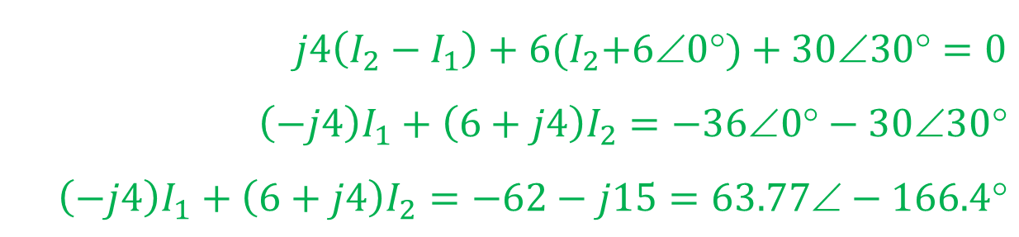
PP 10.3 Find I_{o}.
KVL Loop 1:
$$8I_{1}+\left(−j2\right)I_{1}+j4\left(I_{1}−I_{2}\right)=0$$
$$\left(8+j2\right)I_{1}−j4I_{2}=0$$
$$I_{2}=\frac{\left(8+j2\right)I_{1}}{j4}$$
$$=\left(−j2+0.5\right)I_{1}$$
I₂
I₁
Note: I_{o} = –I₁
1
KVL Loop 2:
$$j4\left(I_{2}−I_{1}\right)+6{(I}_{2}+6∠0°)+30∠30°=0$$
$$\left(−j4\right)I_{1}+\left(6+j4\right)I_{2}=−36∠0°−30∠30°$$
$$\left(−j4\right)I_{1}+\left(6+j4\right)I_{2}=−62−j15=63.77∠−166.4°$$
2

Slide 15
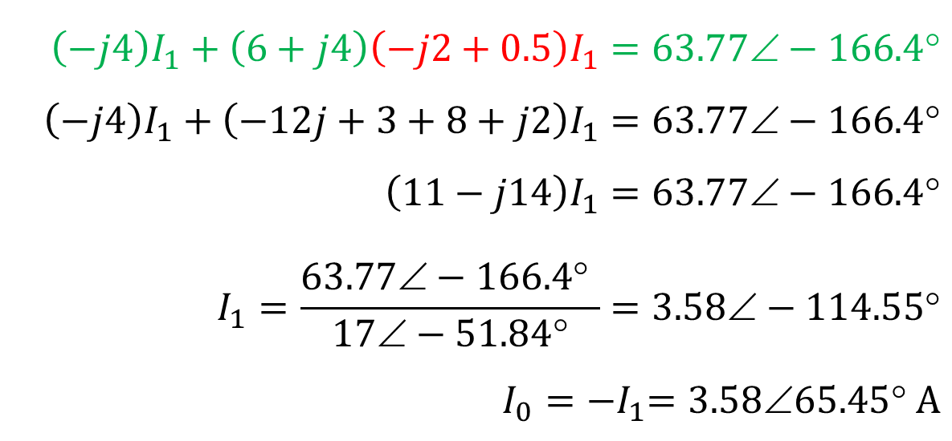
PP 10.3 cont… Find I_{o}.
I₂
I₁
1
2
in :
$$\left(−j4\right)I_{1}+\left(6+j4\right)\left(−j2+0.5\right)I_{1}=63.77∠−166.4°$$
$$\left(−j4\right)I_{1}+\left(−12j+3+8+j2\right)I_{1}=63.77∠−166.4°$$
$$\left(11−j14\right)I_{1}=63.77∠−166.4°$$
$$I_{1}=\frac{63.77∠−166.4° }{17∠−51.84°}=3.58∠−114.55°$$
$$I_{0}={−I}_{1}=3.5865.45 A$$

Slide 16
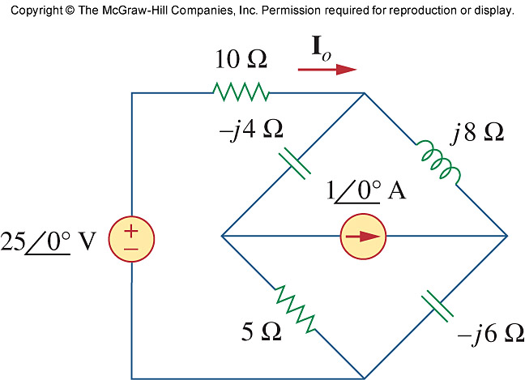
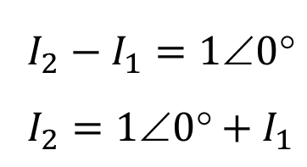
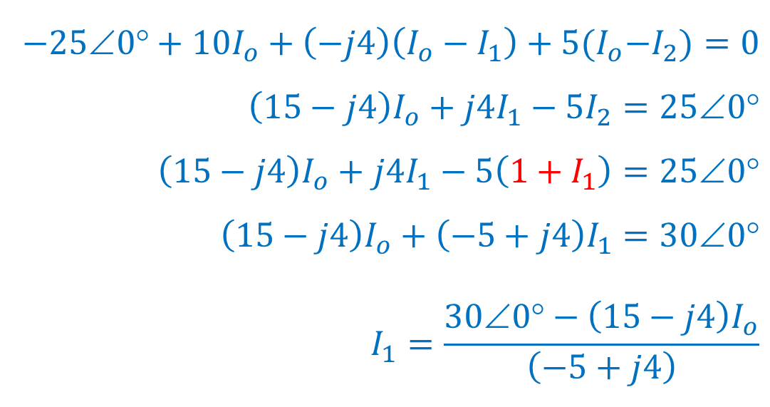
PP 10.4 Find I_{o}.
I_{o}
I₁
$$I_{2}−I_{1}=10$$
$$I_{2}=10+I_{1}$$
Super Mesh:
I₂
1
Loop O:
$$−25∠0°+10I_{o}+\left(−j4\right)\left(I_{o}−I_{1}\right)+5{(I}_{o}−I_{2})=0$$
$$\left(15−j4\right)I_{o}+j4I_{1}−5I_{2}=25∠0°$$
$$\left(15−j4\right)I_{o}+j4I_{1}−5\left(1+I_{1}\right)=25∠0°$$
$$\left(15−j4\right)I_{o}+\left(−5+j4\right)I_{1}=30∠0°$$
$$I_{1}=\frac{30∠0°−\left(15−j4\right)I_{o}}{\left(−5+j4\right)}$$
2

Slide 17
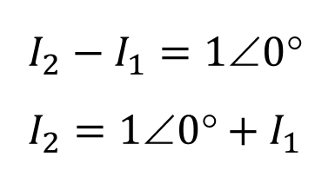
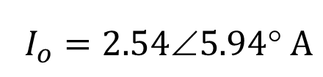
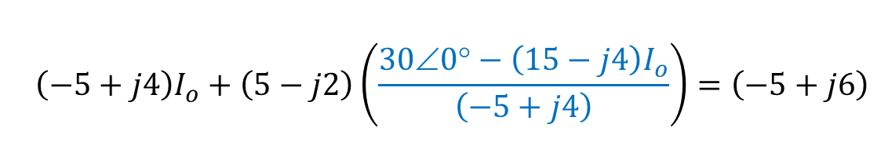
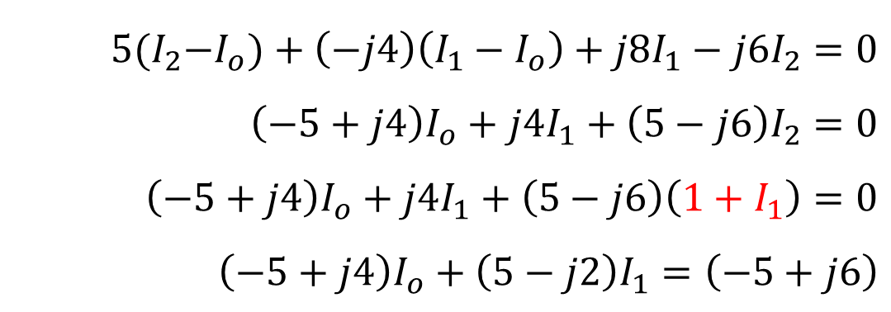
PP 10.4 cont… Find I_{o}.
I_{o}
I₁
$$I_{2}−I_{1}=10$$
$$I_{2}=10+I_{1}$$
Super Mesh:
1
I₂
Super Mesh KVL:
$$5{(I}_{2}−I_{o})+\left(−j4\right)\left(I_{1}−I_{o}\right)+j8I_{1}−j6I_{2}=0$$
$$\left(−5+j4\right)I_{o}+j4I_{1}+\left(5−j6\right)I_{2}=0$$
$$\left(−5+j4\right)I_{o}+j4I_{1}+\left(5−j6\right)\left(1+I_{1}\right)=0$$
$$\left(−5+j4\right)I_{o}+\left(5−j2\right)I_{1}=\left(−5+j6\right)$$
3
$$\left(−5+j4\right)I_{o}+\left(5−j2\right)\left(\frac{30∠0°−\left(15−j4\right)I_{o}}{\left(−5+j4\right)}\right)=\left(−5+j6\right)$$
2
3
in :
$$I_{o}=2.545.94 A$$

Slide 18
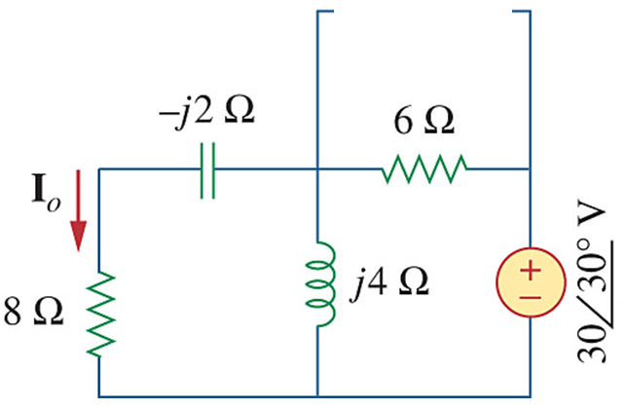
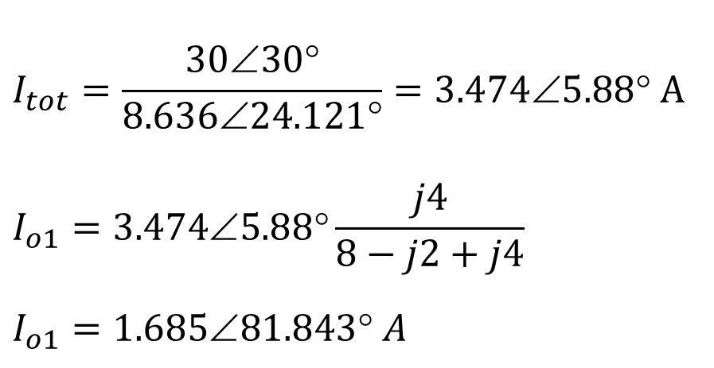
PP 10.5 (Super Positioning) Find I_{o}.
I_{o} due to 30∠30° V source:
Z_{tot} = (8 – j2)//j4 + 6 = 8.636 ∠24.121° Ω
$$I_{tot}=\frac{30∠30°}{8.636∠24.121°}=3.474∠5.88° A$$
$$I_{o1}=3.474∠5.88°\frac{j4}{8−j2+j4}$$
$$I_{o1}=1.68581.843 A$$

Slide 19
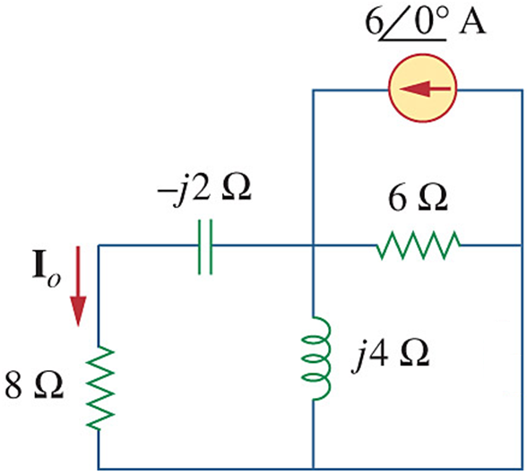
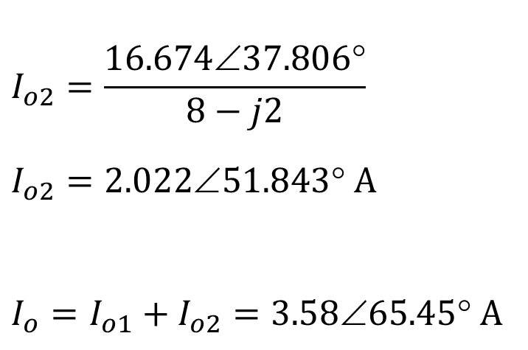
PP 10.5 cont Find I_{o}.
I_{o} due to 6∠0° A source:
Z_{tot} = (8 – j2) // j4 // 6 = 2.779 ∠37.806° Ω
V// = 6∠0°×Z_{tot} = 16.674 ∠37.806° V
$$I_{o2}=\frac{16.674∠37.806°}{8−j2}$$
$$I_{o2}=2.02251.843 A$$
$$I_{o}=I_{o1}+I_{o2}=3.5865.45 A$$

Slide 20
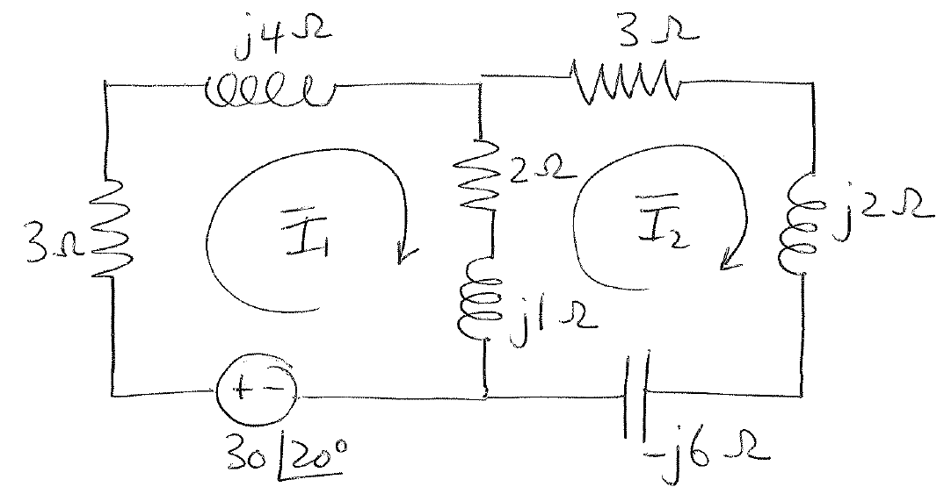
Example 2: Set up the mesh equations for I₁ and I₂. Write it in the following form:
(a₁ + jb₁)I₁ + (a₂ +jb₂)I₂ = A₃∠φ₃
(a₄ + jb₄)I₁ + (a₅ +jb₅)I₂ = A₆∠φ₆

Slide 21
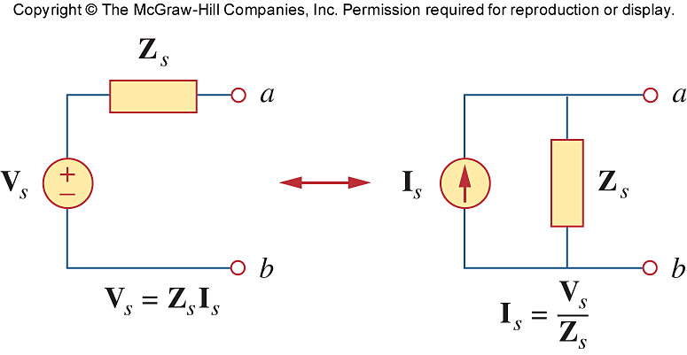
Ch. 10 L#3 10.5 Source Transformation
10.6 Thevenin & Norton
Thevenin Equivalent
Norton Equivalent

Slide 22
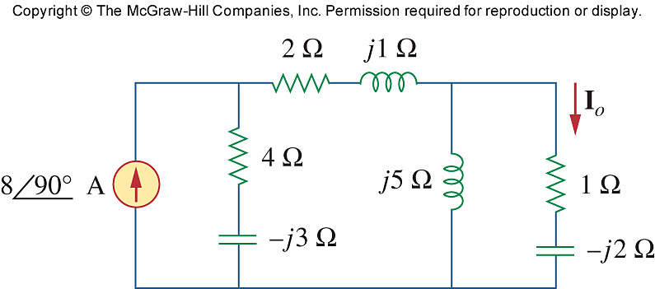
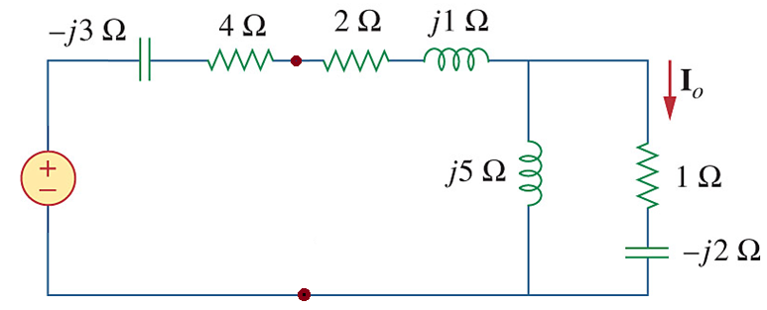
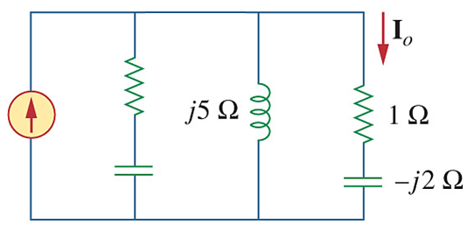
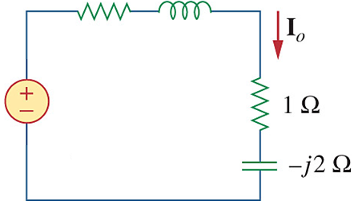
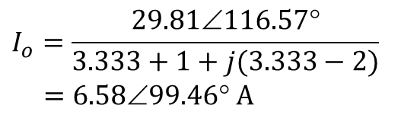
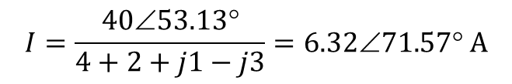
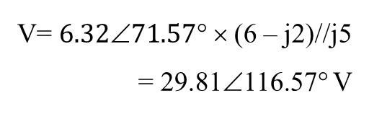
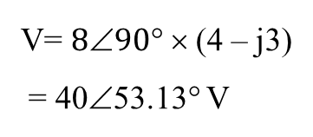
PP 10.7 Find I_{o} using source transformation
V= $890$× (4 – j3)
= 40∠53.13° V
6 Ω
$$I=\frac{40∠53.13°}{4+2+j1−j3}=6.32∠71.57° A$$
–j2 Ω
3.333 + j 3.333 Ω
V= $6.3271.57$× (6 – j2)//j5
= 29.81∠116.57° V
$$I_{o}=\frac{29.81∠116.57°}{3.333+1+j(3.333−2)}$$
$$=6.5899.46 A$$

Slide 23
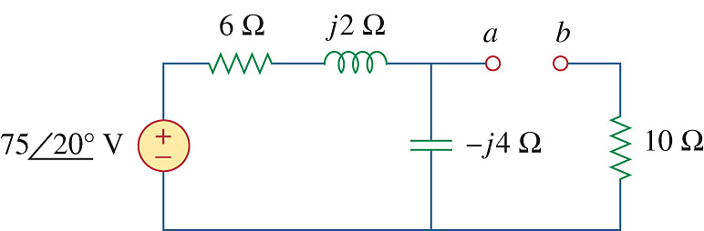
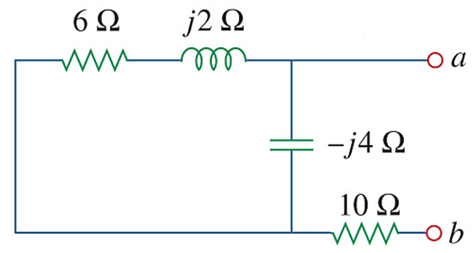
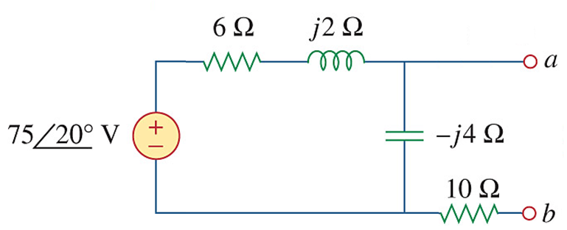
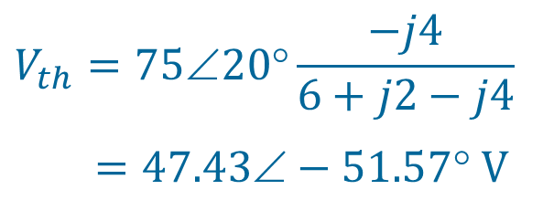
PP 10.8 Find the Thevenin equivalent at terminals a-b of the circuit
Thevenin Impedance: Z_{th}
V_{th} = V_{oc}
+
V_{th}
–
+
V_{th}
–
Z_{th} = (6+j2) // (-j4) + 10
= (12.4 – j3.2)
= 12.81∠-14.47° Ω
Voltage Division:
$$V_{th}=75∠20°\frac{−j4}{6+j2−j4}$$
$$=47.43−51.57 V$$

Slide 24
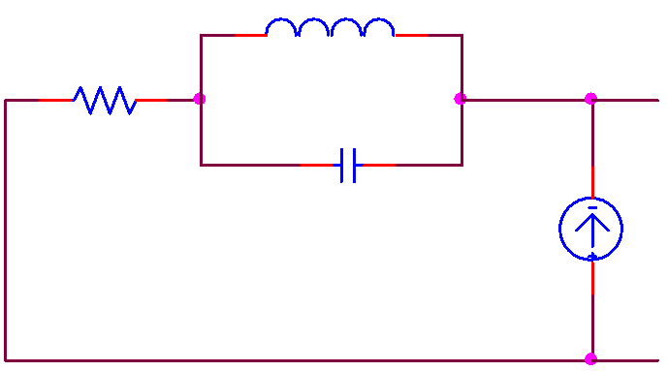
Example 3 Determine the Norton equivalent wrt terminals a-b
6 Ω
j4 Ω
a
-j2 Ω
2∠0°
b
Thevenin Impedance: Z_{th}
I_{source} becomes open circuit
I_{N} = I_{sc} = 2∠0°
Z_{th} = j4 // (-j2) + 6
= (6 – j4)
= 7.21∠-33.7° Ω

Slide 25
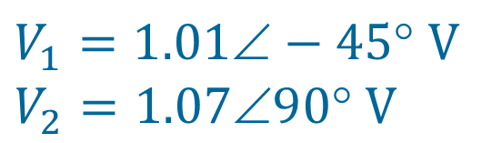
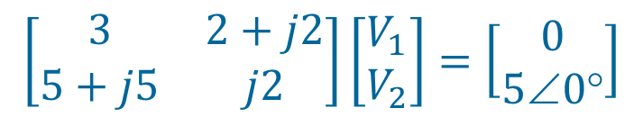
Example 4 Solve the following Matrix
$$\left[\begin{matrix}3 & 2+j2 \\ 5+j5 & j2\end{matrix}\right]\left[\begin{matrix}V_{1} \\ V_{2}\end{matrix}\right]=\left[\begin{matrix}0 \\ 5∠0°\end{matrix}\right]$$
$$V_{1}=1.01−45 V$$
$$V_{2}=1.0790 V$$

